Slide 1
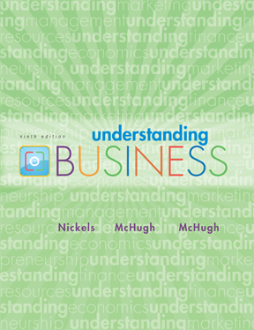

*
Chapter Four
*
Demanding Ethical and Socially Responsible Behavior
(Part-2)
McGraw-Hill/Irwin
Copyright © 2010 by The McGraw-Hill Companies, Inc. All rights reserved.

Slide 2
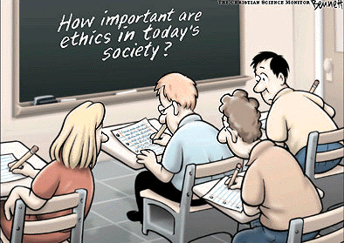
4-<number>

Slide 3

Reasons to Maintain Ethics in Business
To maintain good reputation
To keep existing customers
To attract new customers
To avoid lawsuits
To reduce employee turnover
To avoid government intervention
To please customers, employees, society
And simply to do the right thing
4-<number>

Slide 4

ETHICS START at the TOP
*
Managing Businesses Ethically and Responsibly
*
LG3
    Trust between workers and managers must be based on fairness, honesty, openness and moral integrity.
    Leadership can help instill corporate values in employees.
4-<number>

Slide 5
ETHICS CODES
*
Setting Corporate Ethical Standards
*
LG4
    An increasing number of companies have adopted written codes of ethics.
Compliance-Based Ethics Code -- Emphasize preventing unlawful behavior by increasing control and by penalizing wrongdoers.
Integrity-Based Ethics Code -- Define the organization’s guiding values, create an environment that supports ethically sound behavior and stress a shared accountability among employees.
4-<number>

Slide 6

Steps to Improve
Business Ethics
Top management support
Employees’ understanding
Managers’ training
Ethics Office- whistle blower
Outsiders must be informed
Enforcement of ethics code
4-<number>

Slide 7

Answer the following question
Why a person might be afraid to become a whistle blower? Identify 3 reasons and explain how he or she can deal with it?

